Slide 1
Presentation on spam e-mail detection
Presented by
Akash Pal

Slide 2
introduction
Spam E-mail cannot be only annoying but also dangerous to consumers.
Spam E-mail can be defined as
1.Anonymity
2.Mass Mailings
3.Unsolicited
Spam E-mail are message randomly sent to multiple addressees by all sorts of groups, but mostly lazy advertisers and criminals who wish to lead you to phishing sites.

Slide 3
NAÏVE BAYS CLASSIFIER
Simple probabilistic classifier that calculate that a set of probabilities by counting the frequency and combination of values in a given dataset.
Represent as a vector of feature values.
It is very useful to classify the e-mail properly.
The precision and recall of this method is know to be very effective.

Slide 4
PROBLEM STATEMENT
Unwanted e-mail irritating internet connection
Critical e-mail message are missed or delayed.
Millions of compromised computers.
Billions of dollars lost worldwide.
Identity theft.
Spam can crash mail servers and fill up hard drives.

Slide 5
OBJECTIVE
The objective of identification of spam e-mail are:-
To give knowledge to the user about the fake e-mail and relevant e-mails.
To classify that mail spam or not.

Slide 6
SCOPE OF THE PROJECT
It provides sensitivity to the client and adapts well to the future spam techniques.
It considers a complete message instead of single words with respect to its organization.
It increases Security and Control.
It reduces IT Administration Cost.
It also reduce Network Resource Cost.

Slide 7
DOCUMENT PREPROCESSING
Tokenization
Tokenization is the process of breaking a steam of text up into words, phrases, symbols and other meaningful elements called tokens.
The list of tokens becomes input for further processing such as parsing or text mining.

Slide 8
LEMMATIZATION
Lemmatization in linguistics is the process of grouping together the different inflected forms of a word so they can be analysed as a single item.
In computational linguistics, lemmatisation is the algorithmic process of determining the lemma for a given word.

Slide 9
REMOVAL OF STOP WORD
Sometimes the extremely common word which would appear to be very little value in helping select documents matching user need are excluded from the vocabulary entirely.

Slide 10
REQUIREMENT ANALYSIS
Functional Requirement
To classify the e-mail which is done by first taking out the feature vector extraction which involves first taking out whether the word is a spam or not.
Non-Functional Requirement
Ensure high availability of email data here datasets.
User should get the result as fast as possible.
It should be easy to use i.e., user is just required to type the words and click then the result is displayed or user is just required to enter a pair of reasonable sentence.

Slide 11
FEASIBILITY STUDY
Technical Feasibility
Economic Feasibility
Operational Feasibility

Slide 12
TESTING
We tested the dataset and found out which e-mailis spam and which is non spam indicated as 0 and 1 respectively.
We calculated the feature vector to know whether it is spam or not.
Using that feature vector Naïve Bayes Algorithm works by comparing the trained data to test the data.

Slide 13
Dataset
Dataset is a collection of data or related information that is composed for separate elements.
A collection of dataset for e-mail spam contain spam and non-spam messages.

Slide 14
OUTPUT
Any external email can be detected and classified as spam e-mail, so the user will be aware of such email.
Mails are classified into spam and non spam.
From the classified data we have calculated the accuracy as 98.16%
Precision=99.17%

Slide 15
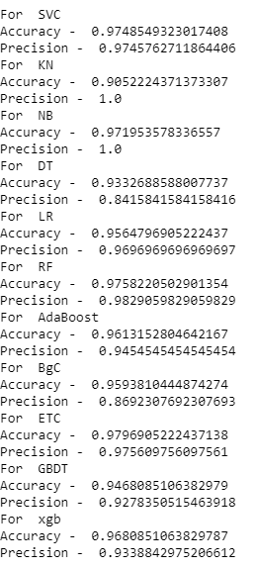

Slide 16
CONCLUSION
We are able to classify the emails as spam or non-spam , with high number of emails lots if people using the system it will be difficult to handle all possible mails as our project deals with only limited amount of corpus.

Slide 17
Thank you

